Slide 1
“LETTER WRITING”
Technical Business Writing
Department of Computer Science

Slide 2
LETTERS
Letters are external correspondence that you send fro your company to a colleague working at another company, to a vendor, to a prospective client, to an agency, or to a friend who lives around the corner or across the continent.
Letters leave your work site as opposed to memos which stay within the company.

Slide 3
IMPORTANCE OF EFFECTIVE LETTERS
Letters must be written effectively because they are sent to readers in other locations.
Letters not only reflect the writers communication abilities but also serve as a reflection of the company.
A letter that is sloppy, marred with grammatical errors, or creates a negative tone leads to bad impression.
If your letter communicates incorrect information regarding prices, guarantees, due-date promises, or equipment and labor commitments, your company will be held legally responsible.

Slide 5
LETTER COMPONENTS
Writer’s address
Date
Inside Address
Salutation
Letter Body
Complimentary Close
Signed Name
Typed Name

Slide 6
1. WRITER’S ADDRESS
Personal address or Company’s address
May use a printed, letterhead stationery
If the heading consists of your address,
  Include your street address(Do not abbreviate the words street, avenue, road, drive, etc)
  Include city, state, and zip code
  Do not include your name
  The state may be abbreviated with the appropriate two-letter abbreviation.

Slide 7
If the heading consists of your company’s address, include:
  The company’s name
  The street address
  The city, state, and zip code

Slide 8
2. DATE
Document the month, day, and year
Select any of the following formats:
  May 31, 2018
  31 May, 2018
WHERE TO PLACE THE DATE:
  One or two spaces below the writer’s address(for longer letters)
  Three to eight spaces below the writer’s address(for shorter letters)

Slide 9
3- INSIDE ADDRESS
Mention address of the receiver of your letter two spaces below the date.

Slide 10
4. SALUTATION
Salutation is placed two spaces beneath the inside address
Preceded by Dear and followed by a colon
  Dear/Respected Mr. Smith:
If you are writing to a woman and unfamiliar with her marital status: Dear/Respected Ms. Jane:
If you know the woman’s marital status: Dear/Respected Mrs. Jane:

Slide 11
5- BODY OF LETTER
Two spaces below the salutation
Single-spaced with double spacing between paragraphs
  INTRODUCTORY PARAGRAPH
    Tell them why you are writing(reason)
  DISCUSSION PARAGRAPH(S)
    Elaborate the reason
  CONCLUDING PARAGRAPH
    Tell them what you expect in return

Slide 12
6- COMPLEMENTARY CLOSE
Placed followed by a comma
Two space below the concluding paragraph
Yours truly/sincerely yours/sincerely

Slide 13
7-SIGNED NAME
Signed beneath the complimentary close

Slide 14
8-TYPED NAME
Four spaces below the complimentary close
If you wish, you may type your title one space beneath your typed name

Slide 15
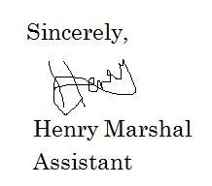
EXAMPLE OF TYPES AND SIGNED NAME

Slide 16
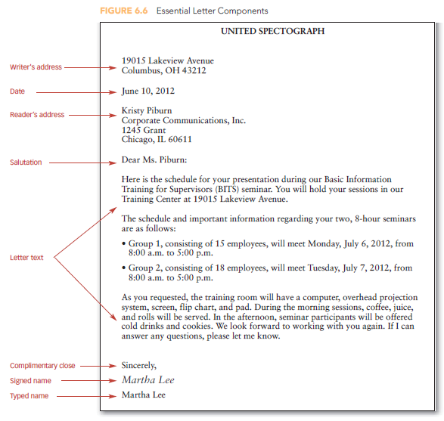

Slide 17
OPTIONAL COMPONENTS OF A LETTER
Subject Line
New Page Notation
Writer and Typist’s notation
Copy Notation

Slide 18
SUBJECT LINE
Placed two spaces below the reader’s address and two spaces above the salutation.
It helps the reader understand your reason of writing the letter

Slide 19
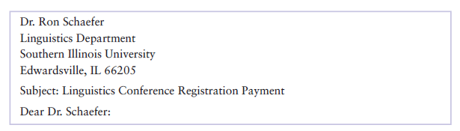

Slide 20
NEW PAGE NOTATION
If your letter is longer than one page, then mention your name, page number, and the date on all the pages after page 1.
These details can be mentioned in two ways, either on the top of the page or on the top left side. The different options are shown on the next slide:

Slide 21
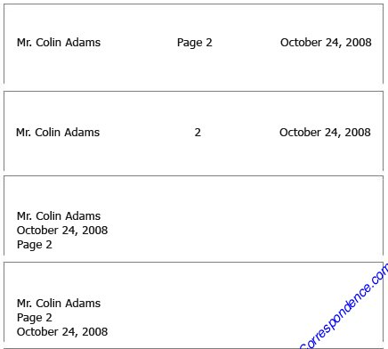

Slide 22
WRITER’S AND TYPIST’S INITIALS
If the letter was typed by someone other than the writer, include both the writer’s and typist’s initials two spaces below the typed signature.
The writer’s initials are capitalized and the typist’s initials are typed in lowercase. Both these initials are separated by a colon.
If the typist are writers are the same person then there is no need to include this.

Slide 23
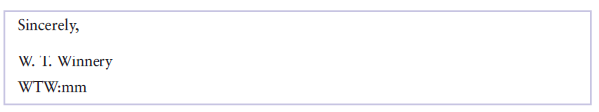

Slide 24
ENCLOSURE NOTATION
If your letter prefaces enclosed information, such as an invoice or report, mention this enclosure in the letter and then type an enclosure notation two spaces below the typed name or writer and typist’s initials.
The enclosure can be abbreviated “Enc”.
Show the numbers of enclosures such as Enclosures (2) or specify what has been enclosed such as Enclosure: January Invoice

Slide 25
COPY NOTATION
If the letter has been sent to other readers, show this in a copy notation.
Complimentary Copy is designed by a lowercase as cc.
Type the copy notation two spaces below the typed name or writer and typist’s initials or the enclosure notation.

Slide 26
